Slide 1
IDV Tutorial
((The screenshot images and the corresponding instructions in the notes can be pasted into the website. ))

Slide 2
Introduction to IDV
IDV Overview
Integrated Data Viewer (IDV) is an effective 3D visualization tool for practicing and demonstrating computational thinking skills using meteorological concepts as the application. This is a tutorial on how to create your own IDV project using fundamental variables in meteorology that are covered during this experience viewed in both the vertical and horizontal planes.
Download Model Data
Use the model data source guide provided and its steps to download the model data file from a specific day and time of your choice to display in your IDV project.

Slide 3
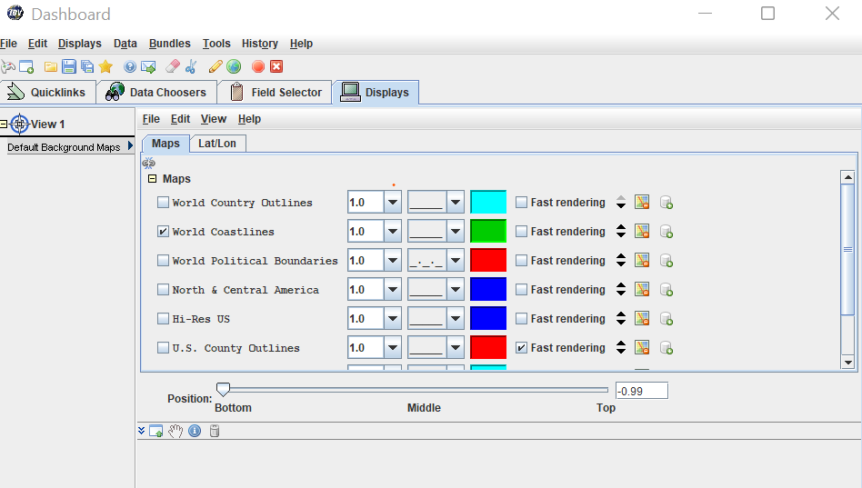
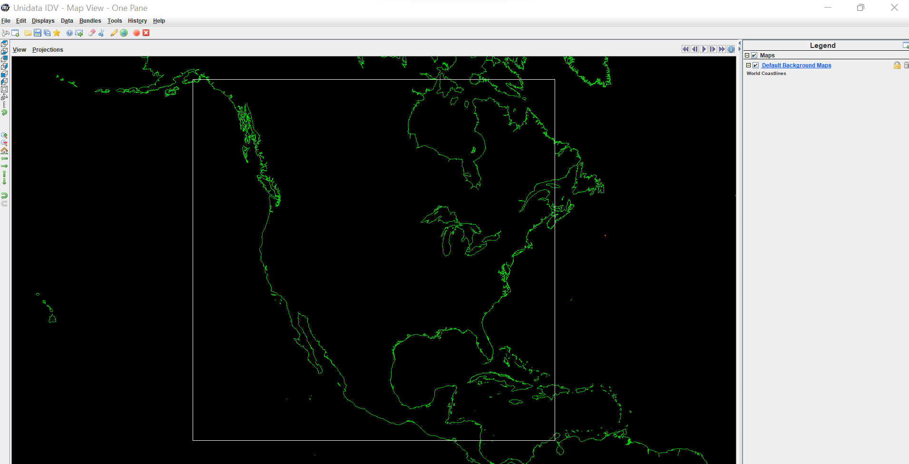
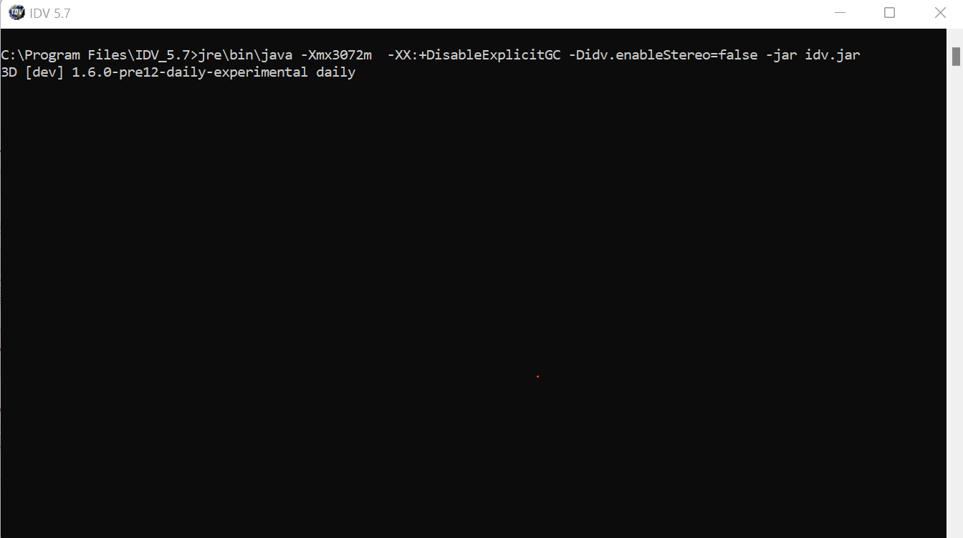
(1)
(2)
(3)
Notes:
Need to know before you begin:
When you first open IDV, 3 separate windows will open on your desktop. It is important to not exit any of these windows, but you can minimize and expand these windows as needed.
The Dashboard is where you will choose and customize your displays that appear in the Map View.
The Map View is where your project will be displayed to use as a 3D visualization tool.
The third window is where the background java scripting is occurring as you build for project. The third window can remain minimized while you create your project, as you will not need to interact with this window.

Slide 4
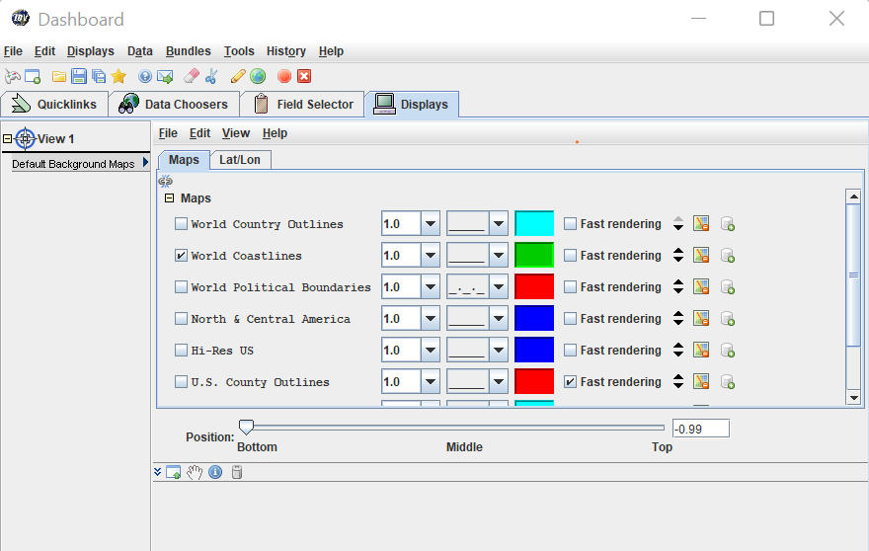
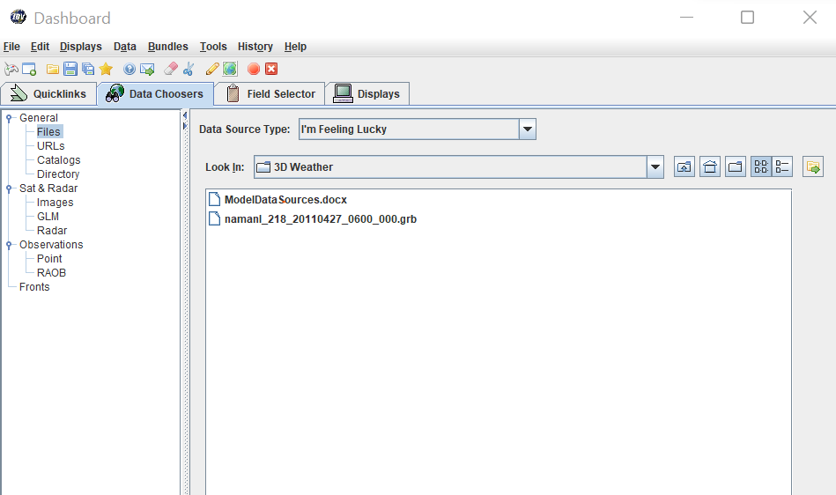
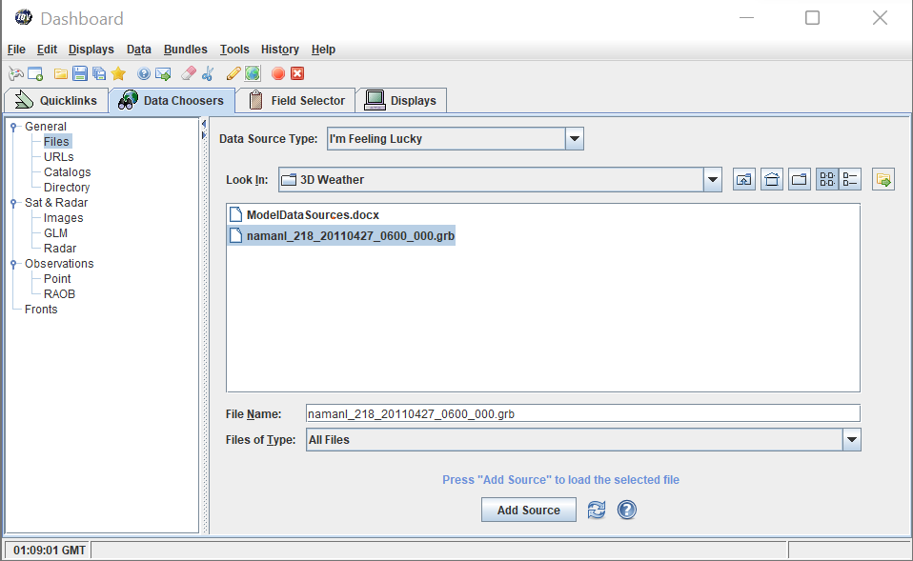
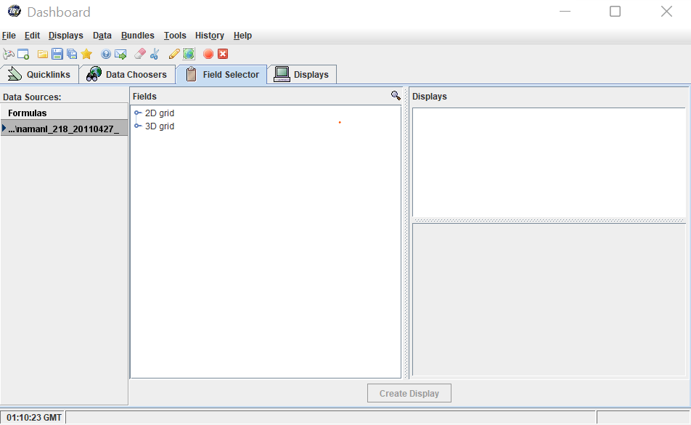
(1)
(2)
(3)
(4)
Notes:
Selecting the Data Source:
After reviewing the Model Data Source Guide, you should have your data file downloaded into a folder on your desktop. Now we will follow the steps on how to pull the model data into IDV.
Click the Data Choosers tab on your Dashboard window.
Your source type will remain “I’m Feeling Lucky”. Use the dropdown menu by “Look in” to select the folder where your model data or .grb file was saved.
Select the .grb file for your project and click “Add Source”.
Once you add your source data, it’ll switch to the “Field Selector” tab next to “Data Choosers”.

Slide 5
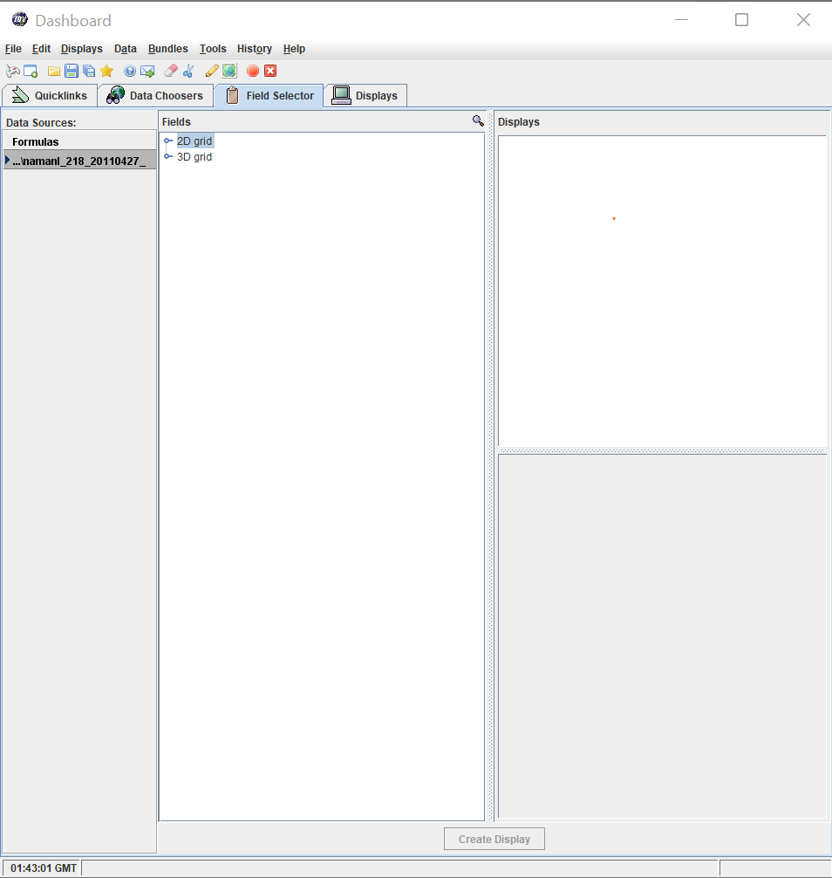
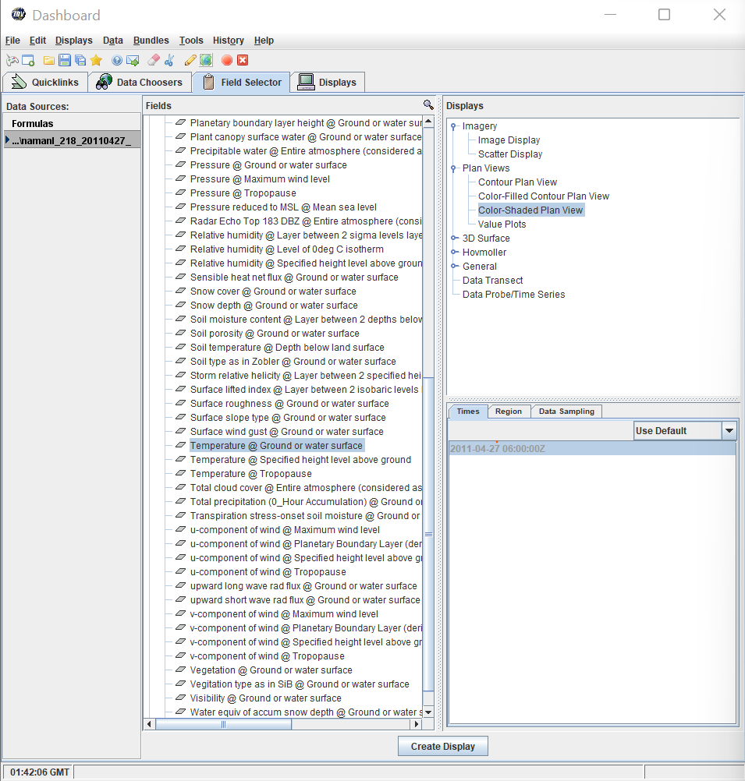
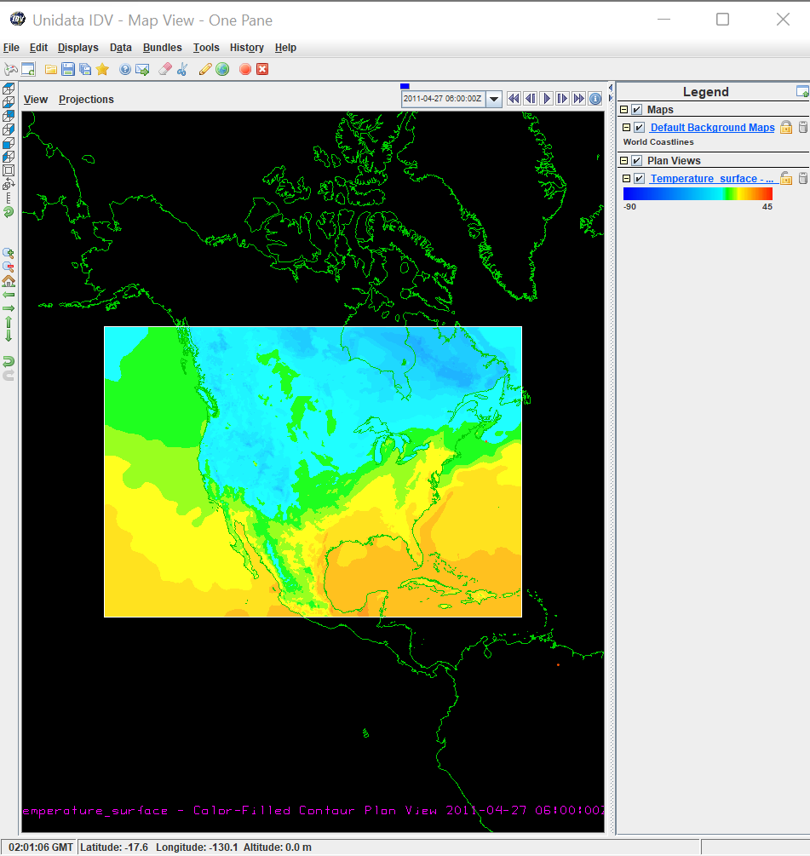
(1)
(3)
(6)
(4)
(2)
(5)
Notes:
Display Surface Temperature:
The “Field Selector” is where you choose which plane you wish to display your weather variable. In this case, our weather variable is surface temperature.
Since we are displaying temperature on a horizontal field at the surface, choose 2D grid.
Once 2D grid is selected, scroll to find “Temperature at Ground or Water Surface”.
Because we’re showing horizontal field, choose “Plan View”.
More options will become available under Plan View. “Color shaded Plan View” is a good option to make your display to look aesthetically appealing to the eye and easily interpreted. Although, any option under Plan View can be used when displaying surface temperature.
Once you’ve selected your field and display type, click “Create Display”.
The surface temperature measurements will appear in your Map View, and the surface temperature display will appear in the Legend on the right-hand side of the window.

Slide 6
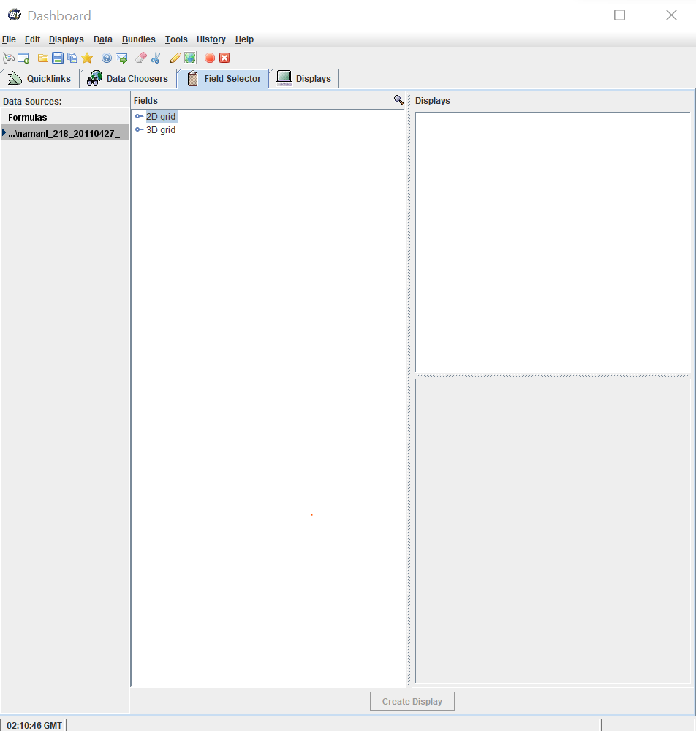
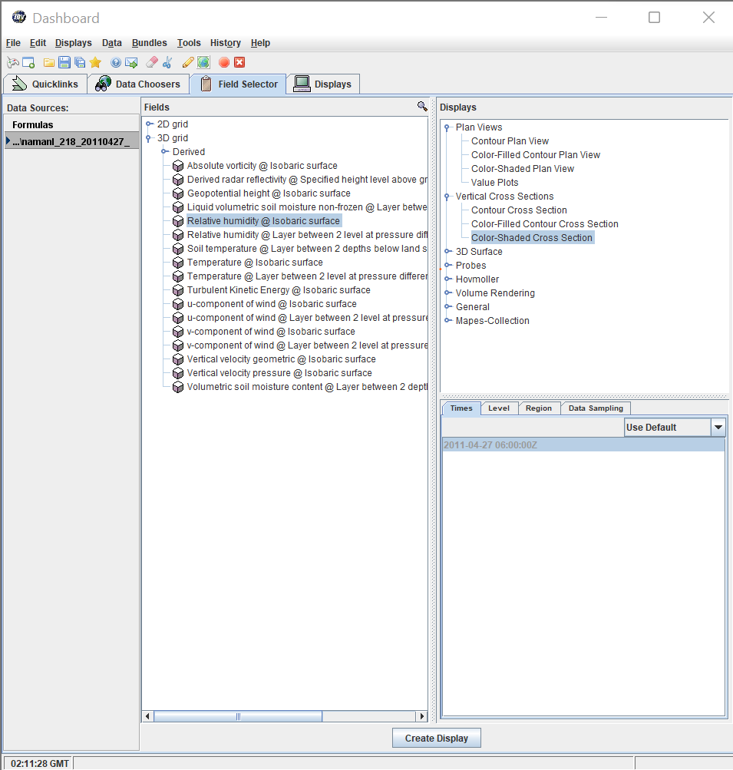
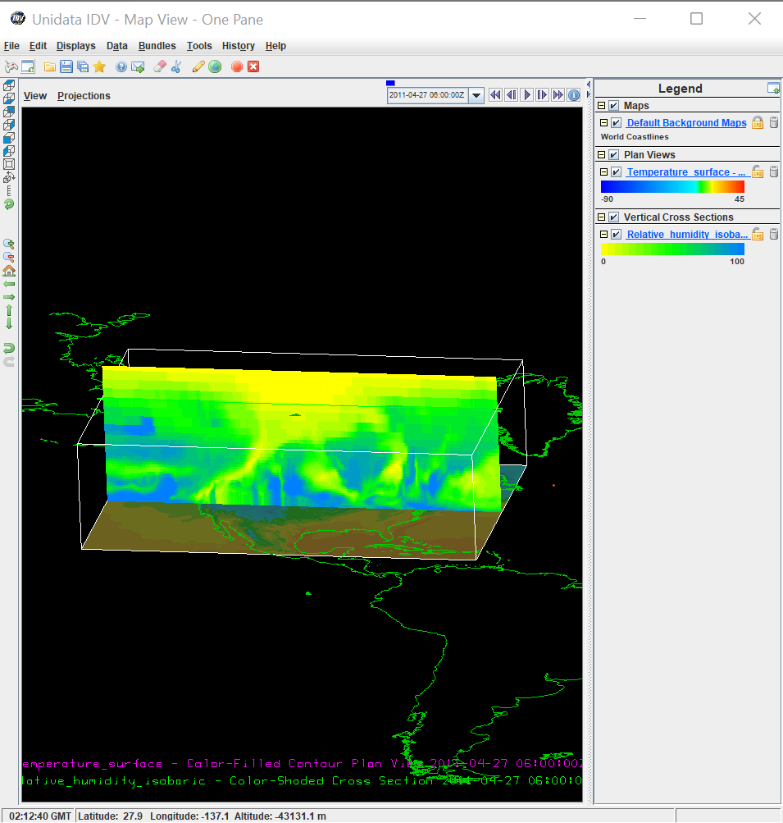
(1)
(3)
(2)
(4)
(6)
(5)
Notes:
Display Vertical Cross Section of Relative Humidity:
Since we are displaying the vertical cross section of Relative Humidity, choose 3D grid.
Once 3D grid is selected, scroll to find “Relative Humidity @ Isobaric Level”.
Because we’re showing cross section, choose “Vertical Cross Section”.
“Color shaded Plan View” is a good option to make your display to look aesthetically appealing to the eye and easily interpreted. Although, any option under Vertical Cross Section can be used.
Once you’ve selected your field and display type, click “Create Display”.
The vertical cross section of Relative Humidity will appear in your Map View, and the Relative Humidity display will appear in the Legend on the right-hand side of the window.

Slide 7
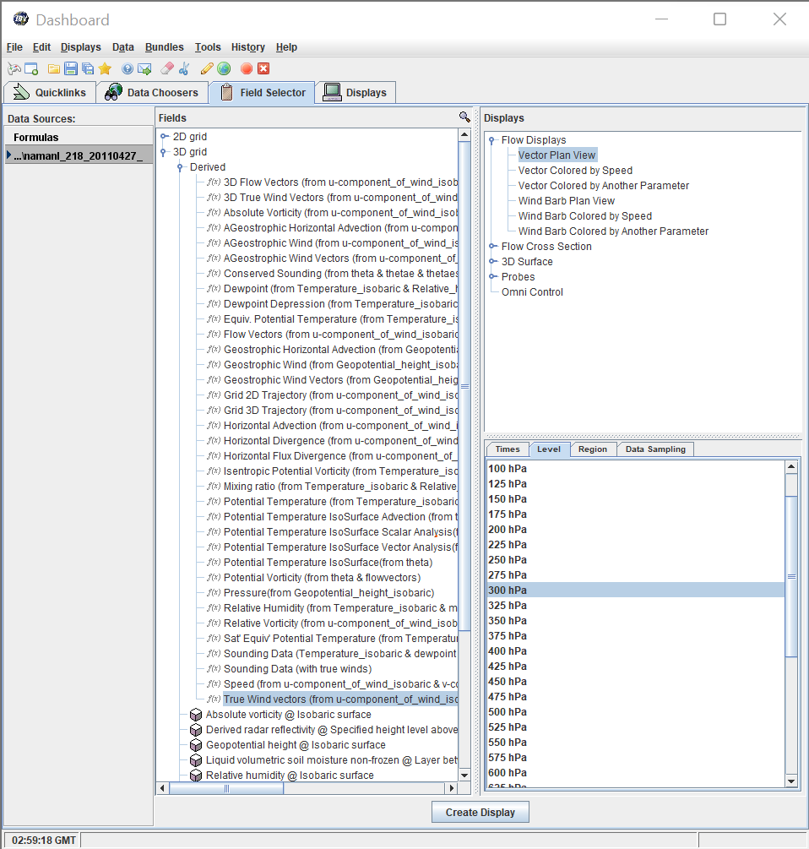
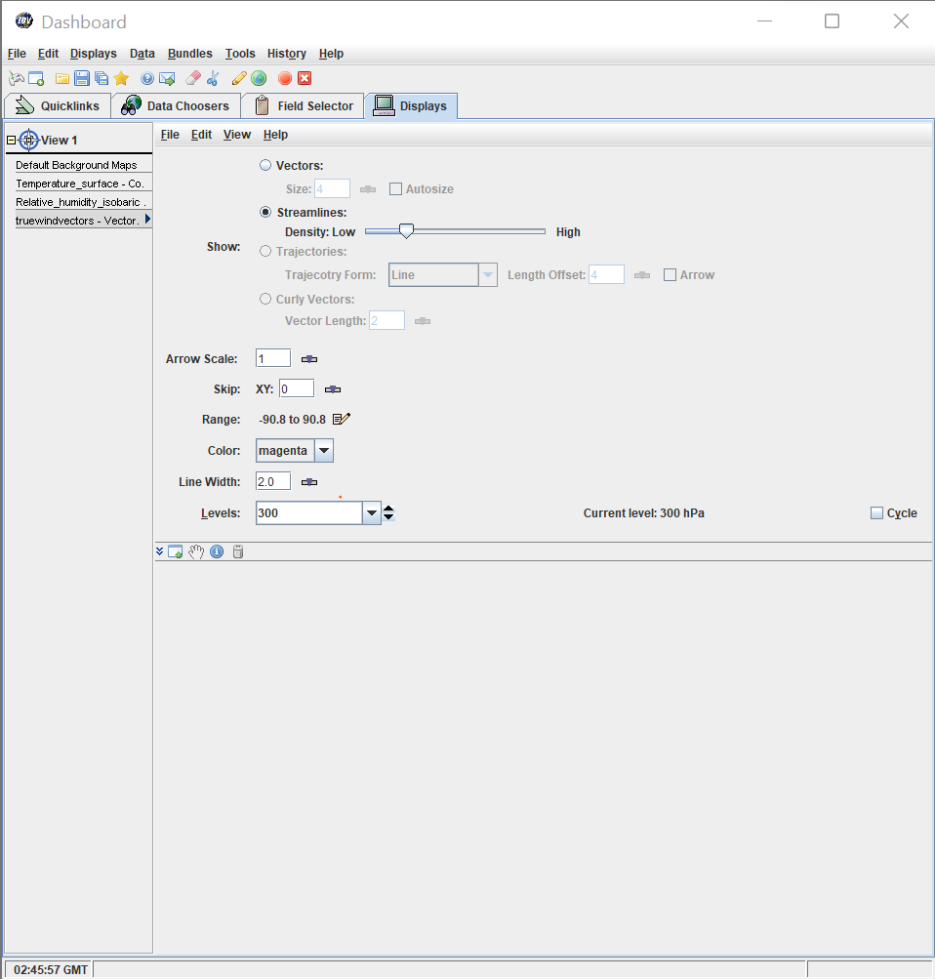
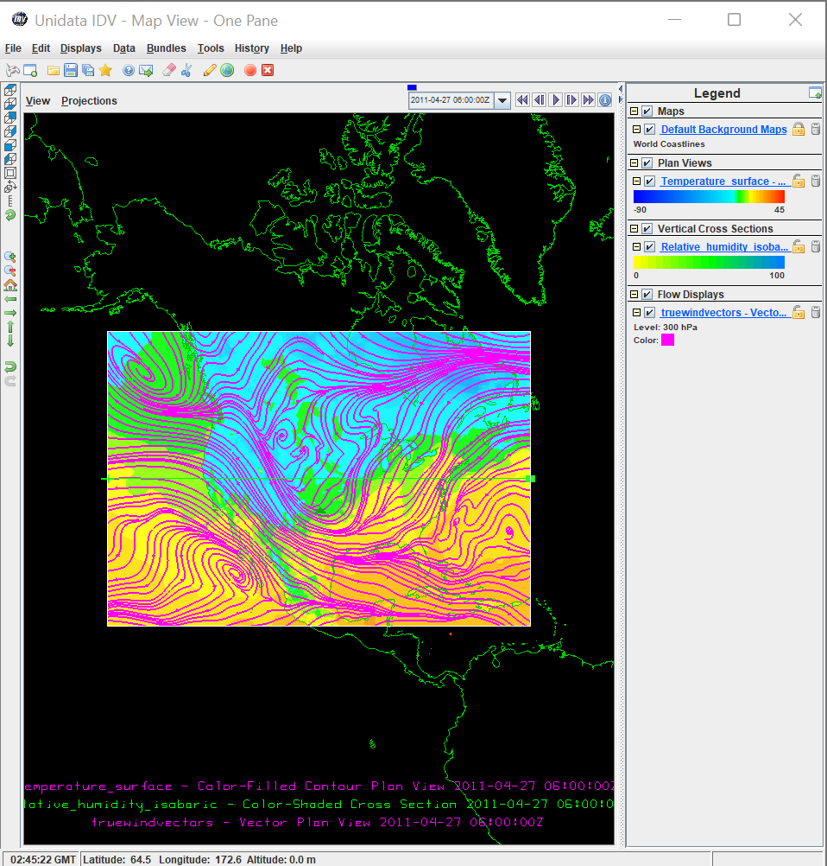
(1)
(4)
(2)
(8)
(9)
(5)
(6)
(3)
(7)
Notes:
Display 300 mb Winds on Horizontal Field Aloft:
Since we are displaying a horizontal field aloft, choose 3D grid.
Once 3D grid is selected, expand ”Derived”.
Choose “True wind vectors (from u-component-of-wind-isobaric & v-component-of-wind-isobaric)”.
Because we’re showing wind aloft, under flow display choose “Vector Plan View”.
We are displaying winds aloft at 300 mb so click the “Level tab”.
Choose “300 hpa”.
Click “Create Display”.
On the Dashboard, it will switch to the display tab. Choose “Streamlines”, and wind patterns will display in your Map View.
To change the colors of the streamlines, click the colored box in the legend under your true wind vectors.

Slide 8
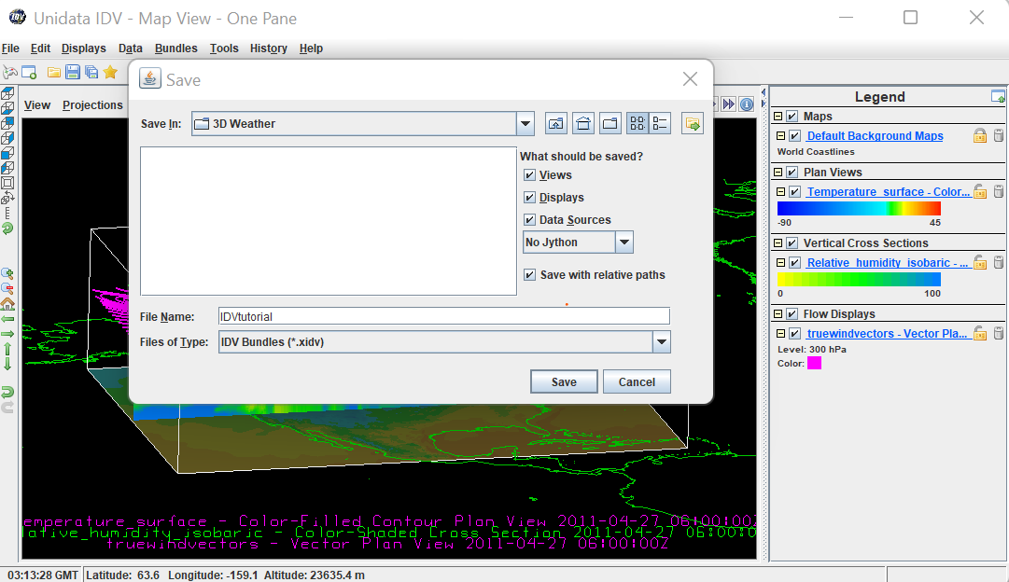
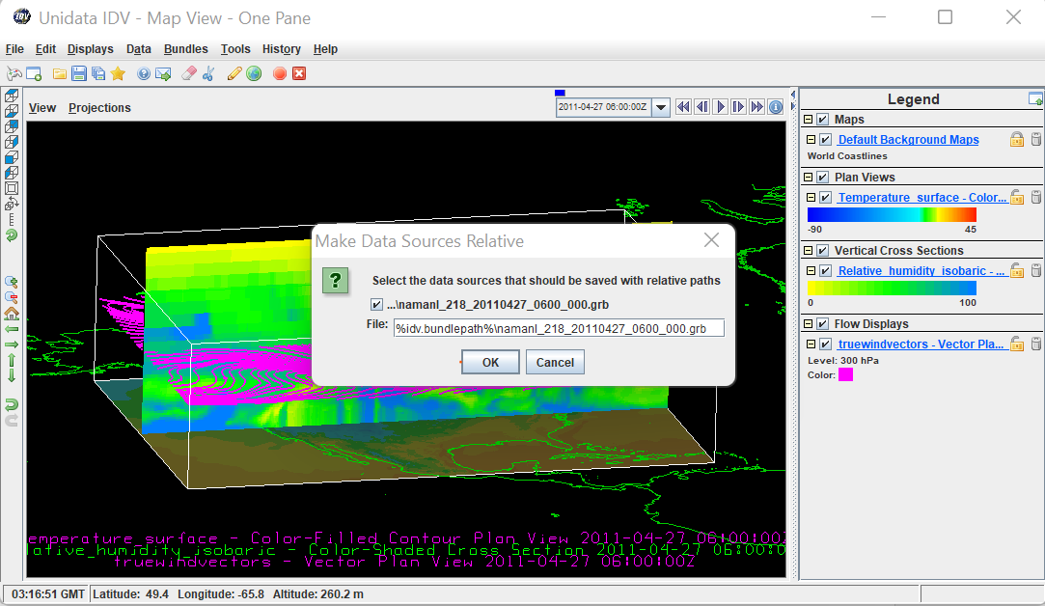
(1)
(2)
(4)
(5)
(3)
Notes:
How to save your IDV Project: VERY IMPORTANT STEPS
It is critical to save your IDV project in the same folder that your model data source (.grb file) is saved into on your desktop. If you do not save your project in the same folder, it will not be able to open.
It is also critical that when saving your IDV project, you check the box beside “Save with relative paths”. You will lose your progress if you do not check this box.
Click “Save”.
Another pop-up menu will open. Check the box beside the data file you used to create your IDV project. You will not be able to open your IDV project if you do not check this box.
Click “Ok”.

Slide 9
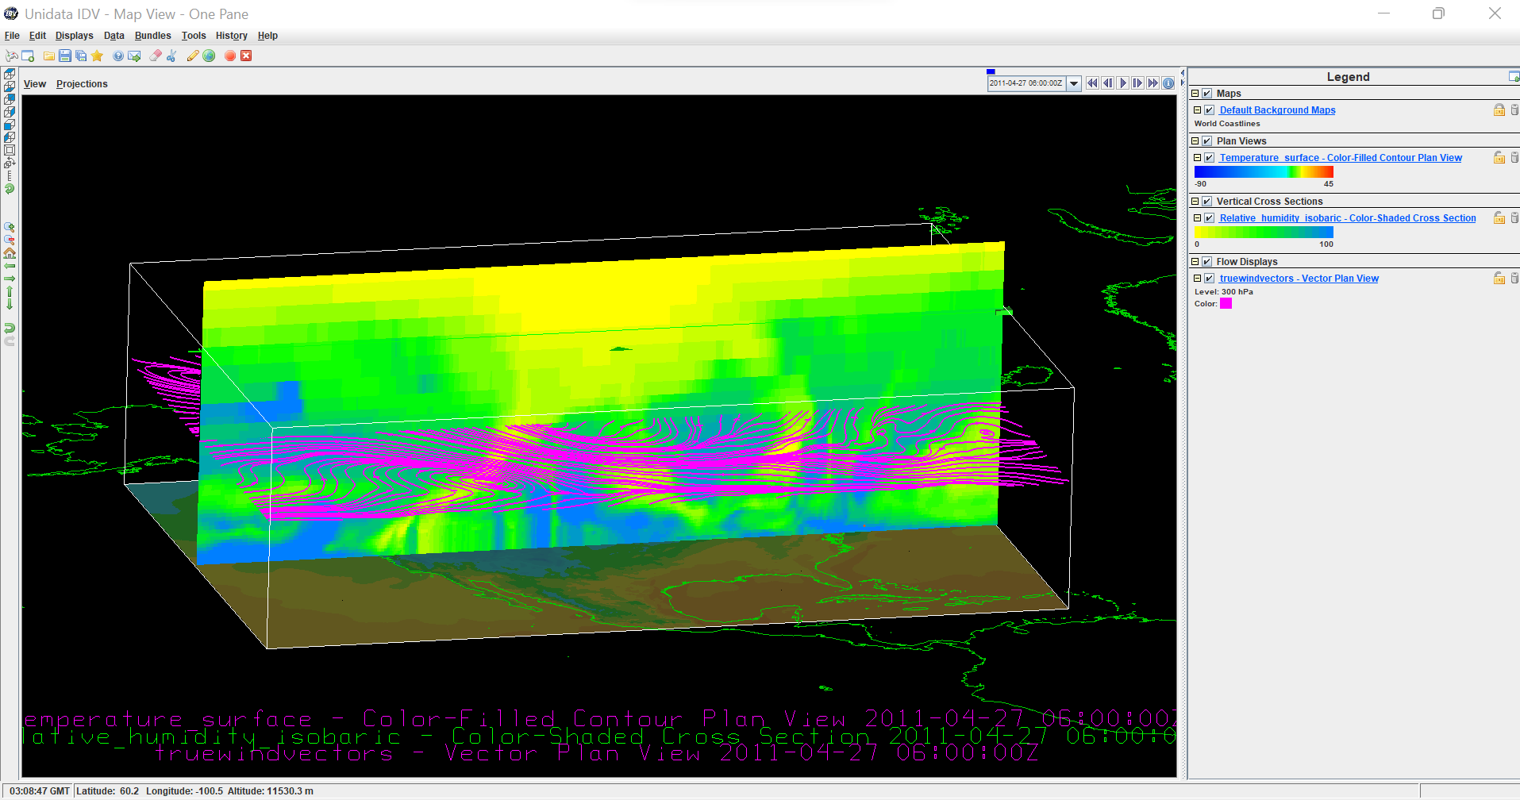
Notes:
Finished Project:
Plan View
Temperature at ground or water surface.
Vertical Cross Section
Relative Humidity
Flow Display
300 mb Streamlines
After your finished project is saved, experiment with the controls on the left hand side of the Map view window. If you mess up and the project has been previously saved, just exit it and reopen it.

